Slide 1
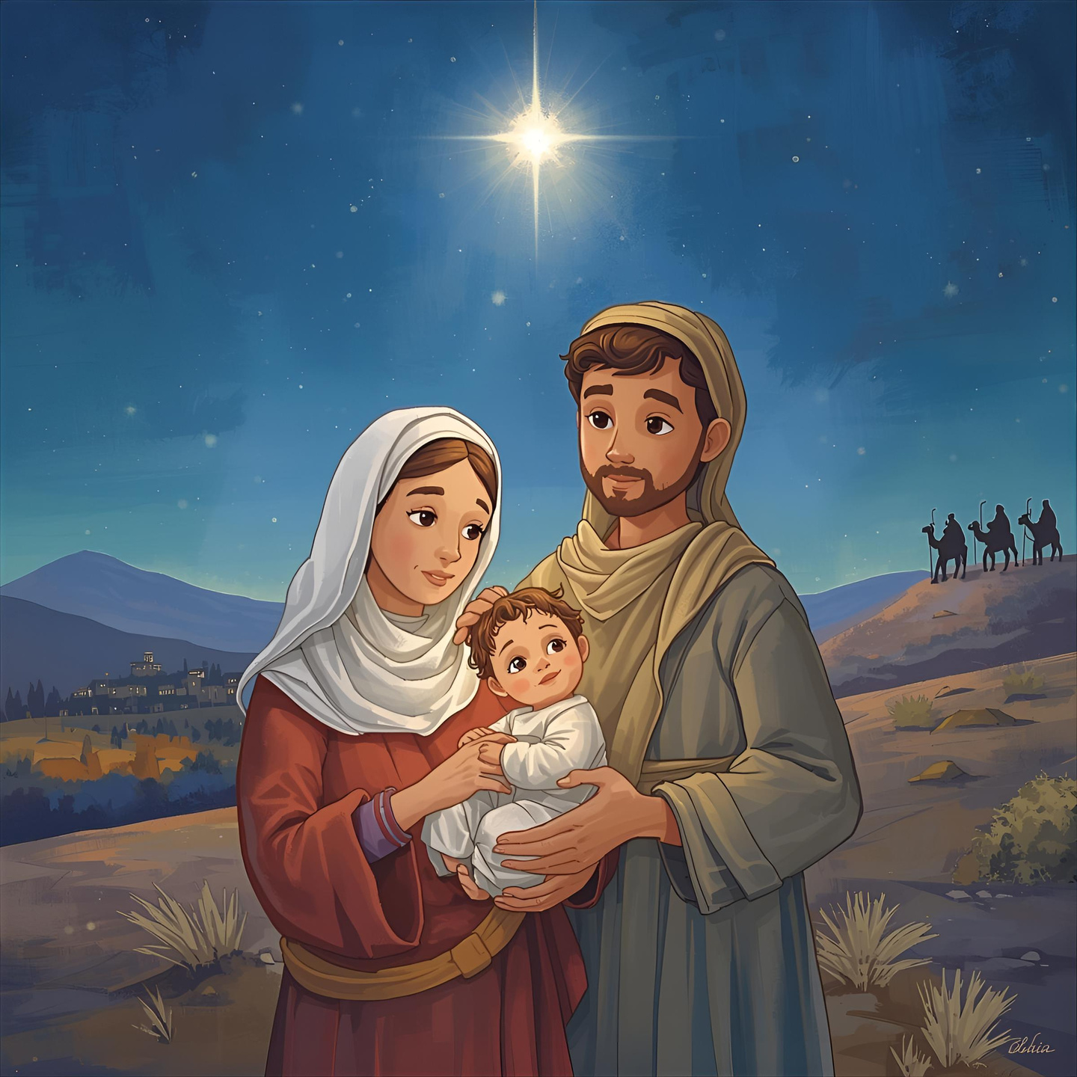
Matthew Chapter 2: The Visit of the Wise Men
By H.A. Bria

Slide 2
Matthew Chapter 2: The Visit of the Wise Men
By H.A. Bria
Images created using Canva Pro
2025
By H.A. Bria

Slide 3
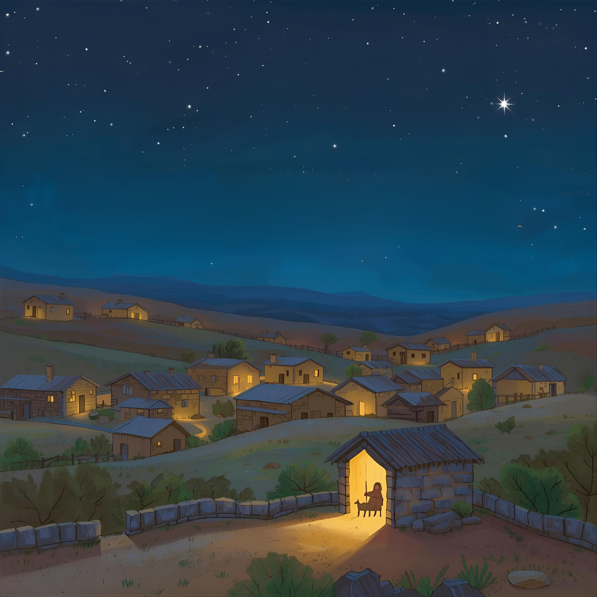
Jesus was born in a small town called Bethlehem, in the land of Judea, at a time when a king named Herod ruled.

Slide 4
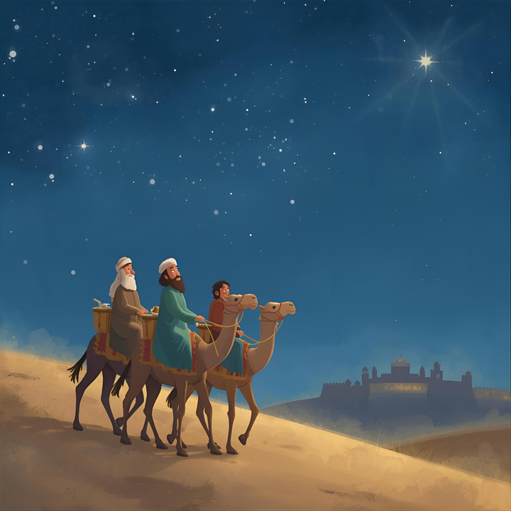
Far away in the East, there were wise men who watched the night sky. One night, they saw a new, shining star rise. They knew this was no ordinary star, it was a sign from God.
So the wise men began a long journey,
following the star, all the way to the great city of Jerusalem.

Slide 5
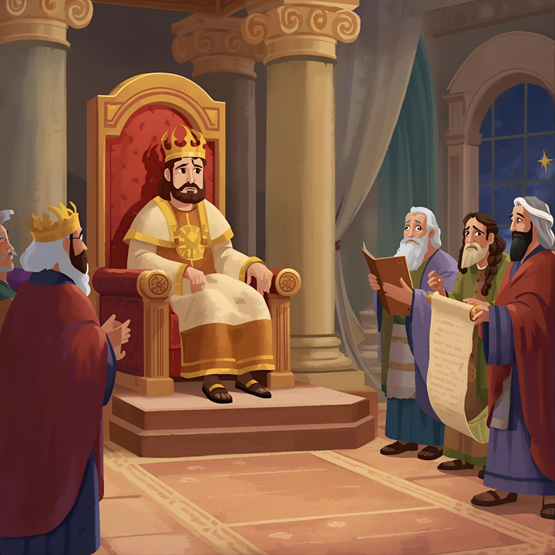
When King Herod heard about a new “king of the Jews,” he became very upset. He called together all the chief priests and teachers of the Law.
“Where will the Messiah be born?” Herod asked them.
They answered,
“The prophet wrote that a leader will come from Bethlehem, a shepherd-king who will guide God’s people, Israel.”

Slide 6
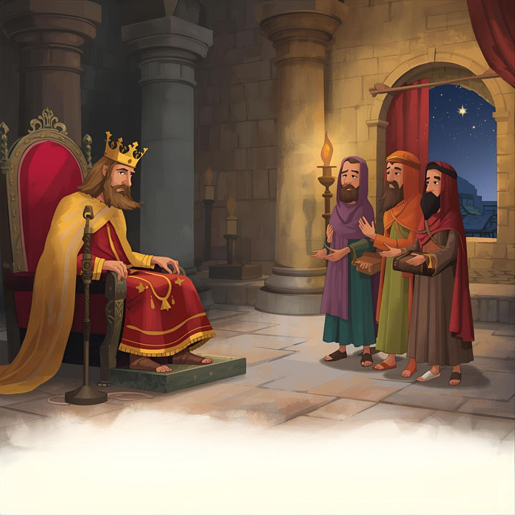
King Herod called the wise men to a secret meeting. He told them,
“Go to Bethlehem and search carefully for the child. When you find Him, come back and tell me, so that I too may go and worship Him.”
But King Herod was not being truthful.
He did not really want to worship Jesus,
he was afraid of losing his power and wanted to harm him.

Slide 7
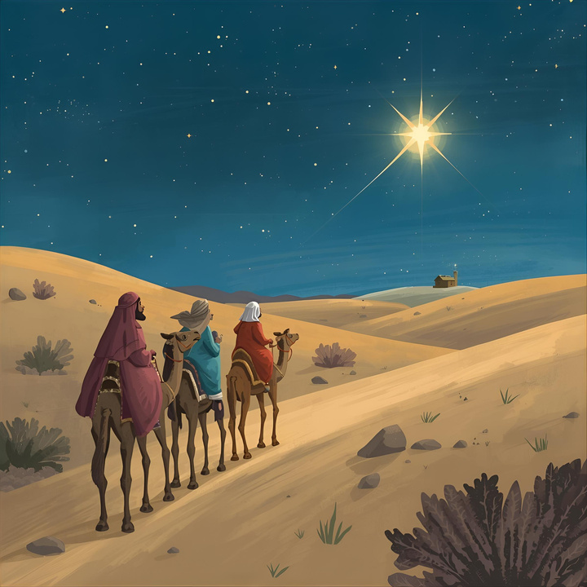
The wise men left Jerusalem, and as they traveled, they saw the same bright star shining in the sky above them. Their hearts leapt with joy, and they followed the star until it stopped right over the place where Jesus was.

Slide 8
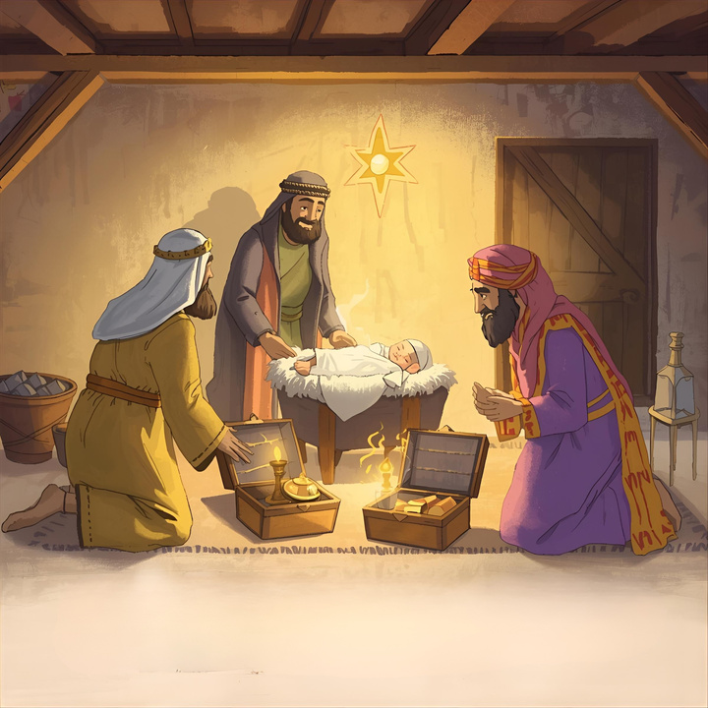
The wise men went into the house and saw the child Jesus with His mother, Mary,
and Joseph by her side.
The wise men knelt down on their knees and worshiped the child Jesus.
Then they opened their treasures and offered their gifts of shining gold,
sweet-smelling frankincense, and myrrh, a precious perfume.

Slide 9
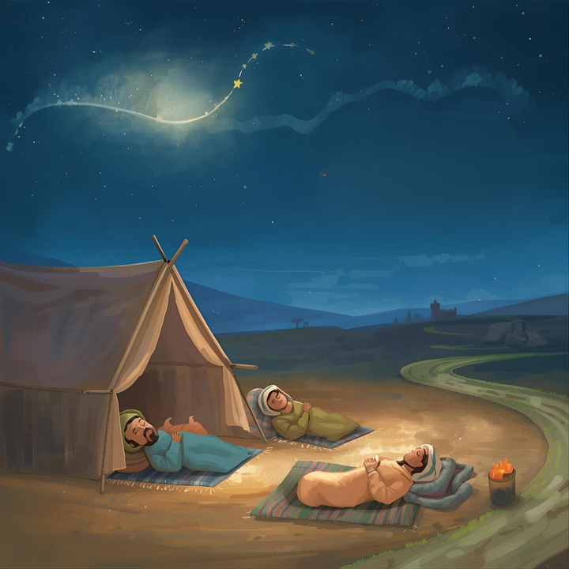
That night, God spoke to the wise men in a dream.
“Do not go back to Herod,” God warned them.
The wise men obeyed God and traveled home to their country by another road.

Slide 10
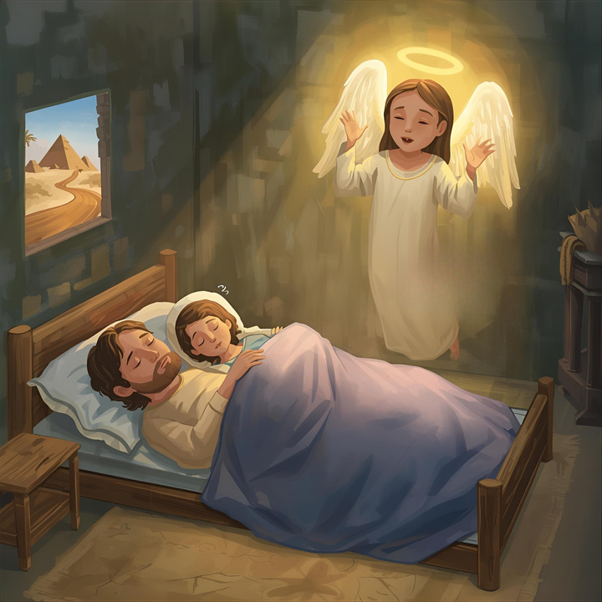
After the wise men left, an angel of the Lord appeared to Joseph in a dream.
“Get up!” the angel said.
“You must take Mary and Jesus and escape to Egypt. Stay there until I tell you it is safe to leave. Herod is looking for your child and wants to harm Him.”

Slide 11
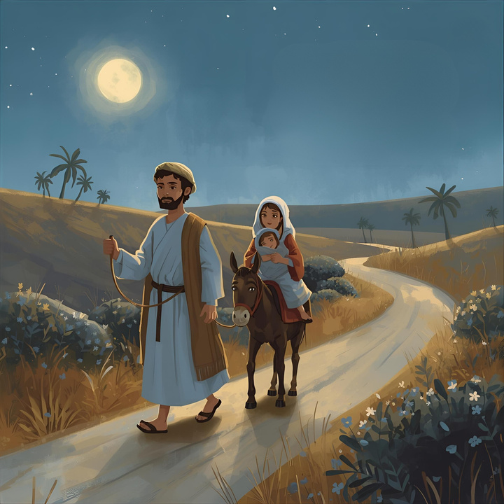
Joseph woke up. Without waiting for morning, he took Mary and the child Jesus and they slipped away into the night,
traveling all the way to Egypt.
Joseph, Mary, and the child Jesus stayed in Egypt until King Herod died. In this way, God’s promise came true, He would call His Son out of Egypt.

Slide 12
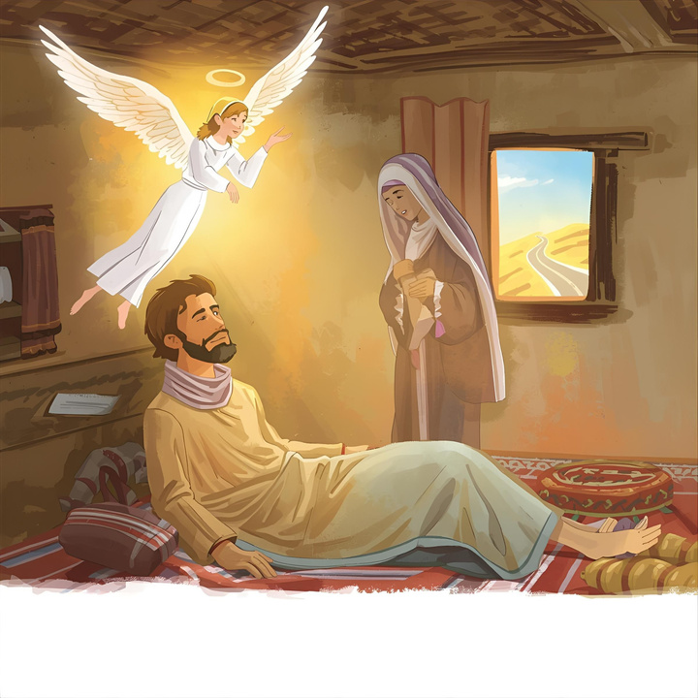
An angel of the Lord appeared once again to Joseph and said,
“Get up. Take Jesus and Mary back to the land of Israel, for the ones who wanted to harm the child are gone.”
Joseph obeyed the angel of the Lord and began his journey back to Israel with Mary and Jesus by his side.

Slide 13
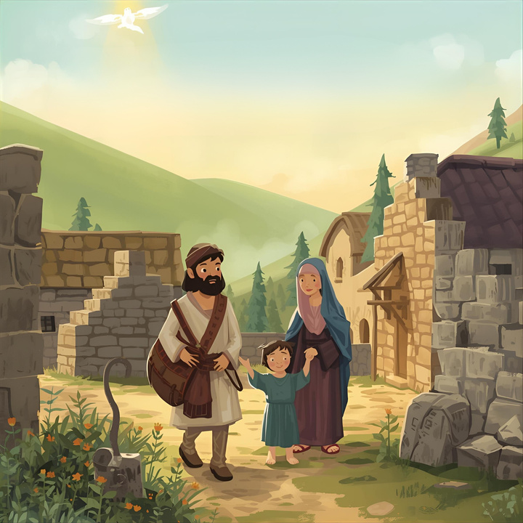
But when Joseph heard that Herod’s son Archelaus was now ruling in Judea, he was afraid to go there. Once more, God guided Joseph in a dream. Joseph went to the region of Galilee instead, and the family made their home in a small town called Nazareth.
In this way, the words of the prophets came true: “He will be called a Nazarene.”

