Slide 1
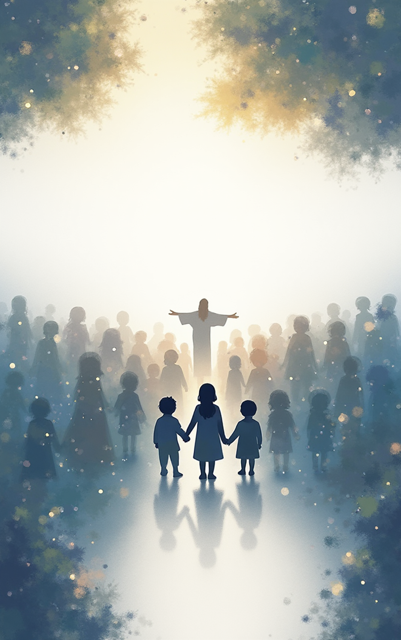
Matthew Chapter 1: The Ancestors of Jesus Christ
By H.A. Bria

Slide 2
By H.A. Bria
Images created using Canva Magic Pro 2025

Slide 3

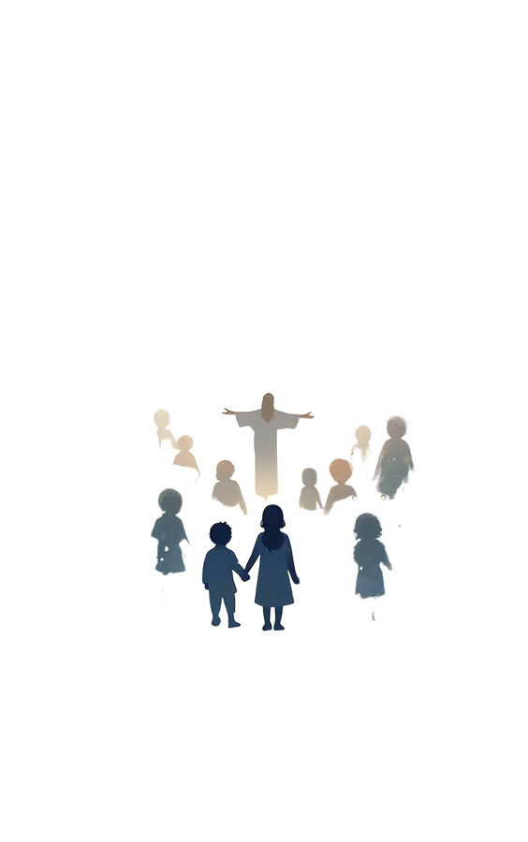
Matthew Chapter 1: The Ancestors of Jesus

Slide 4

Long before Jesus was born, God was tenderly preparing the world for the coming of our Lord and Savior.

Slide 5
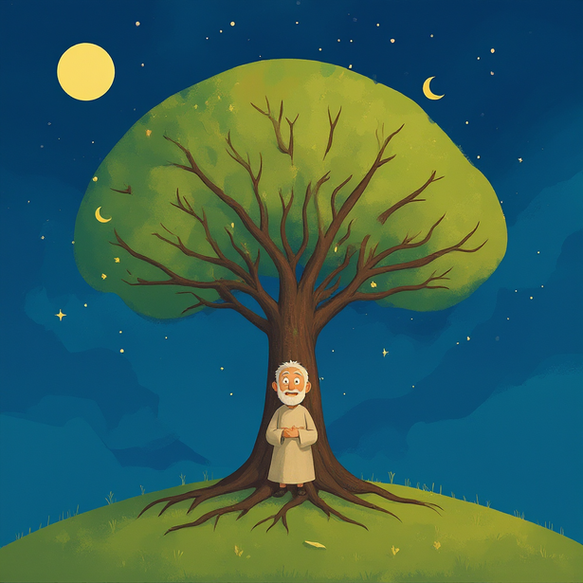
God’s people kept a special family list,
a way to remember how God’s love
was quietly at work through many generations.
At the top of this great family tree stood Abraham, the man God promised to bless
with a family as countless as the stars in the sky.

Slide 6
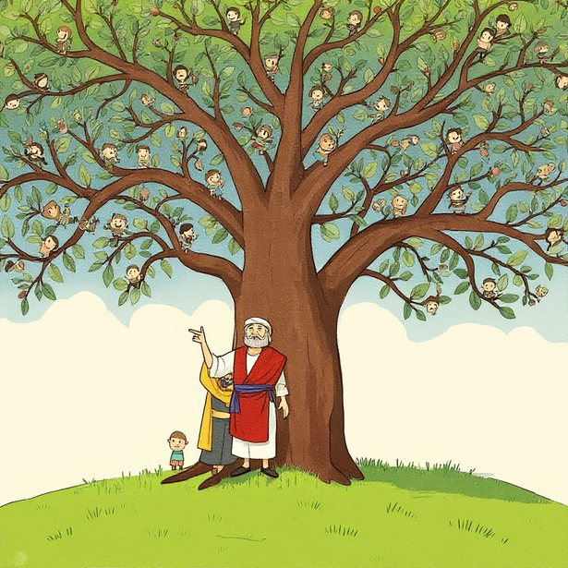
Abraham had a son named Isaac. Isaac had a son named Jacob. Jacob’s family grew and grew, with many sons, including Judah.
Generation after generation, new babies were born, and the family of God kept growing and growing.

Slide 7

From this ever-growing family came a boy named Boaz, and later a child named Obed, and then Jesse, who had a son named David.
David grew to be a great king, and God made him a promise:
“A descendant from your family will be a very special king.”

Slide 8
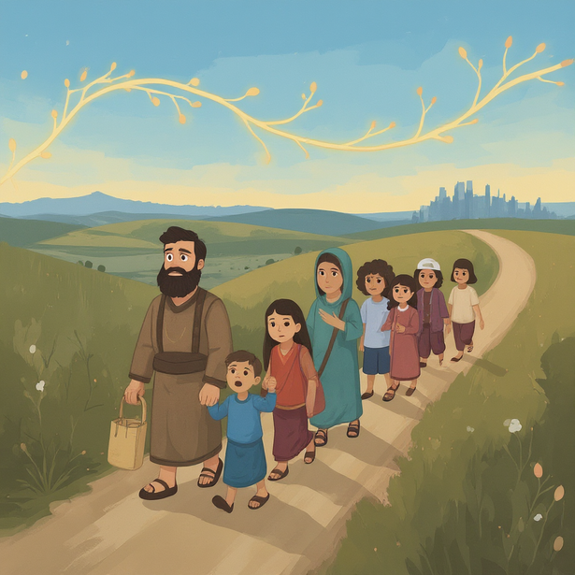
Years passed, and many kings came and went. Some kings listened to God, and some turned away.
One day, God’s people were taken far from home to a land called Babylon, but God’s promise kept shining quietly
in their hearts.

Slide 9

Even when God’s people were far from home, the family tree of Abraham and David kept on growing.
New babies were born, Shealtiel, Zerubbabel, and many more, each one part of a beautiful story that God was writing with His people.

Slide 10
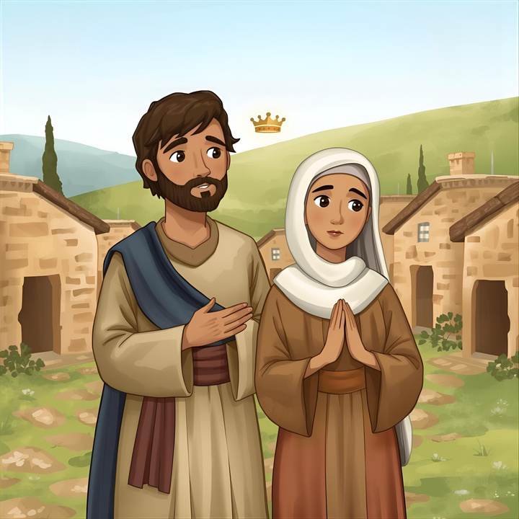
At the end of this long line of God’s family
came a man named Joseph, a carpenter from the family of King David.
Joseph was engaged to a young woman named Mary, whose heart belonged completely to God.

Slide 11
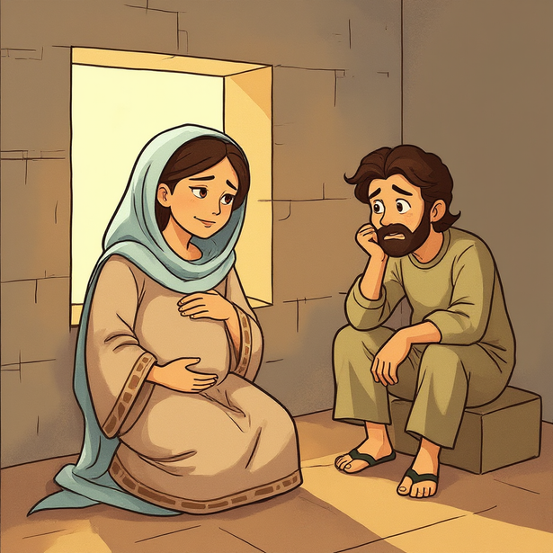
One day, Mary learned she was going to have a baby, a baby given to her by God. Joseph did not understand at first. He was kind and wanted to do what was right, but this news left his heart confused and afraid.

Slide 12
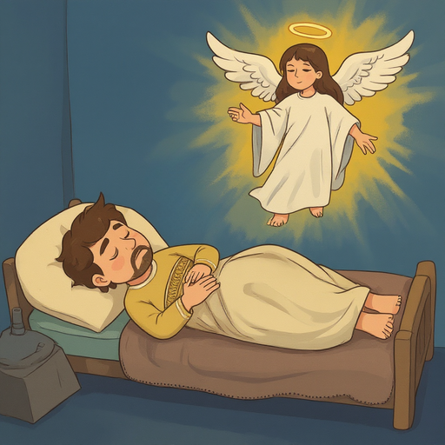
One night, an angel of the Lord appeared to Joseph in a dream.
“Joseph,” the angel said, “descendant of David, do not be afraid to take Mary as your wife. For she will have a son, and you will name him Jesus, and He will be the savior of the world.”

Slide 13
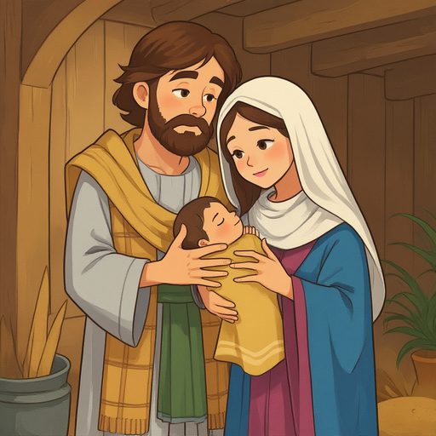
When Joseph woke up, his heart was filled with courage. He trusted God and did just what the angel had said, taking Mary to be his wife.
And when the baby was born,
Joseph and Mary named him Jesus, just as the angel had told them.

Slide 14
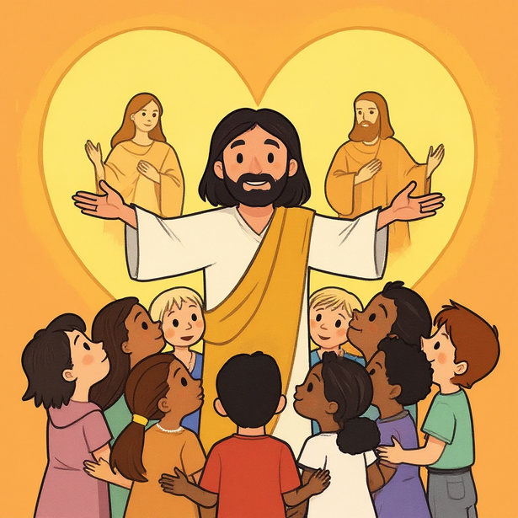
Jesus is the promised child from Abraham’s family and King David’s family, sent to us by God’s great love for His people.
In Jesus, God is with us, now and forever.

